Slide 1
HERMES Training Activities (O3)
Ertuğrul Çimen, MEF University
PROJECT NUMBER 2020-1-IT02-KA226-HE-095624 CUP NUMBER B65F21000120006

Slide 2
Future Directions for Resource Sharing
Ertuğrul Çimen (MA)
Library Director, MEF University
Europe Regional Division Member, IFLA
Freedom of Access to Information and Freedom of Expression, IFLA
cimene@mef.edu.tr
Notes:
Good afternoon, I am Eruğrul Çimen. I am the library director at MEF University. I have been actively involved in many non-governmental organizations in the previous years. As of today, I am a Europe Regional Division member of the IFLA and the member of the Freedom of Access to Information and Freedom of Expression Advisory Board. I am also leading HERMES training activities, representing MEF University Library, as it is a HERMES project partner.

Slide 3
Presentation Plan
Understanding Resource Sharing
Philosophy of Resource Sharing
Components of Resource Sharing
Resource Sharing During Covid-19
RSCVD
HERMES Project and Beyond
What we learned in HERMES Training Activities
Creative Commons
Copy Rights
Ethic Matters
Instruments of Effective Resource Sharing
Open Access
Resource Discovery
New Initiatives (Talaria software)
Expending Resource sharing
Free Services
More Training and Interaction
Notes:
Here is the presentation plan. Today we will start by focusing on the philosophy of resource sharing, following that, we will identify the resource sharing components. Then, we will talk about the document supply services and resource sharing activities during the COVID-19. We will also evaluate the HERMES Project. Then review the achievements of the HERMES training program. In the last part of the session, we will discuss what is expected in the future.

Slide 4
Understanding to Resource Sharing
Philosophy of Resource Sharing
Components of Resource Sharing
Notes:
To understand the meaning of Resource Sharing, we will focus on the philosophy of resource sharing. After that, we will try to figure out the components of resource sharing.

Slide 5
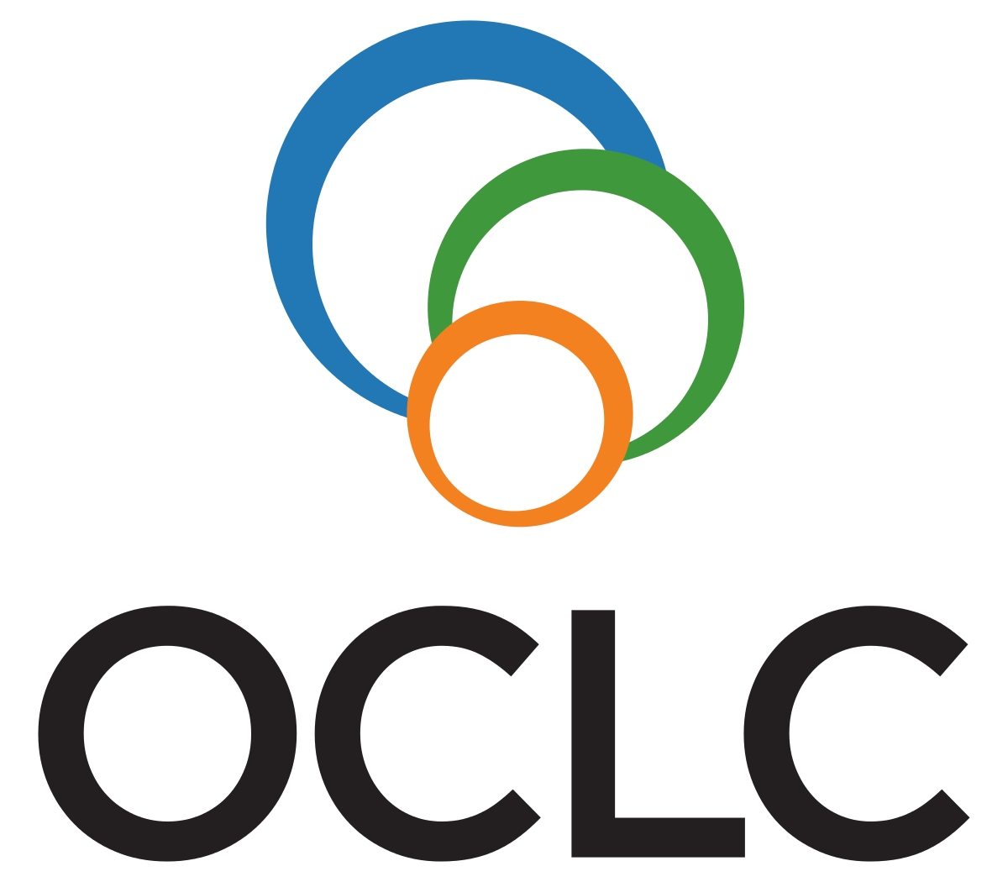
Understanding to Resource Sharing
Philosophy of Resource Sharing
OCLC
RAILS
NILDE
KITS
TUBESS
…
Notes:
Let’s have a look to the “Philosophy of Resource Sharing”
Resource Sharing; means that one library or information center makes its print and electronic resources efficiently and effectively available to users of another library or information center offers for a certain period.
Resource sharing is not a standalone service but, a set of services that includes activities related to mutual access and mutual borrowing, such as a set of operations, and tools (including union catalogs, discovery tools, databases), collection management, bibliographic identification. Resource sharing is a core system service.
Although resource sharing is perceived only as of the sharing of library collections, it refers to the cooperation of more than one library in a broader perspective. Consortium activities based on joint purchases and subscriptions are also within the scope of this collaboration, besides sharing of collections, expertise, facilities.
Resource : Reaching Across Illinois Library System Web Page (https://www.railslibraries.info/)
Resource Sharing Networks
OCLC aims to make it easier ILL services for libraries, OCLC does not care about what type of item requested. OCLC resource sharing network is common service all over the World.
RAILS : serve approximately 1300 academic, public, school, and special library agencies in northern and west-central Illinois. Its services include interlibrary delivery, shared catalog support, continuing education, consulting, shared e-book collections, cooperative purchasing, and more.
The Libraries Australia Document Delivery (LADD): is a system that provided by the National Library of Australia
NILDE (Network Inter-Library Document Exchange) NILDE is a software designed in 2001 by The Library of the CNR (Italian National Research Council) in Bologna (Italy) in the context of the CNR BiblioMIME project. The software, which is used, completely free of charge, has been developed to manage cross-library resource sharing activities. (https://nildeworld.bo.cnr.it/en/content/network)
KITS (Interlibrary Loan Tracking System (KITS)) The aim of the KITS is to manage all interlibrary loan processes between higher education institutions in Turkey as online. Participating institutions can manage all resource sharing activities effectively using the KITS which is a free of charge. (https://kits.ankos.gen.tr/)
TUBESS is an online platform developed by TUBITAK-ULAKBİM and started to be used in 2011 to carry out resource-sharing activities of academic libraries for a certain fee. TUBES platform is a system that works integrated with the TO-KAT platform, which provides a national collective catalog service.

Slide 6
Understanding to Resource Sharing
Components of Resource Sharing
Collection
Technology
software,
platforms,
union catalog,
federated search engines,
library systems,
transport (traditional) / sharing (new-fashioned)
Users
Networks
Staff
Services & facilities
Notes:
• Collection There should be collections of different types of resources, such as print, electronic, etc., where the requested items can be supplied.
• Technology Many technological solutions are needed to provide quick, efficient, and uninterrupted resource-sharing services.
• software, Open source and free, if possible, low-cost software that will speed up the process, facilitate operations and reduce the error rate,
• platform, An online platform that is open to the access of libraries, that requests and meets the demand, and contains all similar services such as union catalog, request form, shipment management, etc.
• union catalog, An online catalog that allows the bibliographic records of different types of libraries and information centers to be searched at the national level and the resources to be accessible,
• federated search engines/discovery tools Federated search engines and discovery tools that provide multiple searches and access to bibliographic records of electronic resources owned by libraries and information centers
• library system, An integrated library automation system, that provides access to bibliographic information and more of the library resources. The system can work in harmony with different software and programs.
• transport (traditional) / sharing (new-fashioned) A transportation system that ensures traditionally requested print items must circulate in suitable conditions in a reasonable time, and reasonable price. It is needed to use secure electronic resource sharing tools to provide under ILL service under the copyright and fair use rules.
• Users The user who needs information but cannot access it with his/her own capacity by using local, regional facilities, or corporate affiliation
• Networks A communication network covering all of the components listed above,
• Staff The expert staff is required to manage the resource-sharing process, by using all these tools and methods listed above.

Slide 7
Resource Sharing During Covid-19
Resource Sharing During Covid-19 (RSCVD) Tool Launched on April 21, 2020, by IFLA DDRSC
The RSCVD is a pilot project supported by librarians more than 100 volunteering libraries all over the world
Only the non-profit libraries can request access to materials from volunteering libraries
Over the past 2 years, approximately 20.000 requests have been delivered electronically to the requesting users
Even it was planned that the project was going to be expired on August 31, 2020, the RSCVD project currently in use
A volunteer librarian Peter Bae is leading the RSCVD project
Notes:
In February 2021, the World Health Organization declared the COVID-19 outbreak a pandemic. Depending on this declaration, travel restrictions began to be implemented all over the world. Continuously countries all over the world started to take to lockdown decisions. Naturally, libraries were also closed, and it was not clear when the pandemic would end. During this period, IFLA DDRSSC decided to launch the RSCVD initiative to provide researchers and library users access to information.

Slide 8
HERMES Project
An opensource software (TALARIA)
Publication
Training lit
Notes:
The HERMES project was launched to make this initiative permanent due to the successful continuation of the RSCVD initiative. The HERMES project is funded by the European Union under ERASMUS+. The project partners are CNR Library (Italy), IFLA (Netherlands), Cantabria University (Spain), Balamand University (Lebanon), and MEF University (Turkey). At the end of the project, it's aimed that three outputs to be achieved.
An open-source ILL software (Talaria) that will provide access to digital resources,
A publication to be used as educational material, aiming to reach the worldwide knowledge community by encouraging the creation of a common perspective in the field of resource sharing,
Preparation of a training kit for the education community (teachers, researchers, students) to strengthen competencies in the search and acquisition of quality academic documents and the preparation of relevant training materials
Almost all of the three outputs aimed for the project have been achieved. The opensource software will be launched very soon, the publication is %90 ready, the training kit created, and the training/dissemination activities started.

Slide 9
HERMES Project and Beyond
What we learned in HERMES Training Activities
Creative Commons
Copy Rights
Ethic Matters
Instruments of Effective Resource Sharing
Open Access
Resource Discovery
Notes:
I hope, the previous sessions were useful for you to have a better understanding of resource sharing. All of the topics were created to facilitate a better understanding of the philosophy of collaboration, resource sharing, and the adoption of a common view in this field at the international level. Developing a common perspective on resource sharing is also among the important outcomes of the HERMES project.

Slide 10
HERMES Project and Beyond
New Tools (Talaria software)
Expanding Resource Sharing
Free Services
More Training and Interaction
Notes:
Finally, let's have a look what is waiting for us in this regard in the future
A program called TALARIA, which is open-source, free, and available to international use, will be put into service,
Efforts will be made to create a social/professional network in a way that will expand the resource-sharing network and ensure the spread of services,
Efforts will be made to ensure that Resource Sharing services are carried out free of charge or at a low cost, if possible, within the scope of copyrights and fair use.
More training will be provided, and mutual interaction will be ensured to adopt an international common perspective

