Slide 1
Resource Sharing
in a Post-Pandemic World
PROJECT NUMBER 2020-1-IT02-KA226-HE-095624 CUP NUMBER B65F21000120006
Peter Collins, OCLC (USA)
Peter Bae, Princeton University Library (USA)
Silvana Mangiaracina, CNR Bologna Research Area Library (Italy)
Ertugrul Cimen, MEF University Library (Turkey)

Slide 2
RSCVD: Resource Sharing
in the Times of COVID
PROJECT NUMBER 2020-1-IT02-KA226-HE-095624 CUP NUMBER B65F21000120006
Peter Bae, Princeton University Library (USA)

Slide 3
What ILL community can do
in the times of Pandemic?

Slide 4
RSCVD (or ‘received’) : Resource Sharing in the times of COVID
National resource sharing network is jeopardized and no reliable International Resource Sharing network exists.
Discussion Started in March 2020 with colleagues of NILDE in Italy and IFLA Document Delivery and Resource Sharing Section Standing Committee.
Situations in Italy, Europe, and World Wide.
A minimalistic workflow. (“let’s start first.”)
Assistance of OA.Works for Web Request Form
Rscvd.org
First Requests received on April 21st 2020.

Slide 5
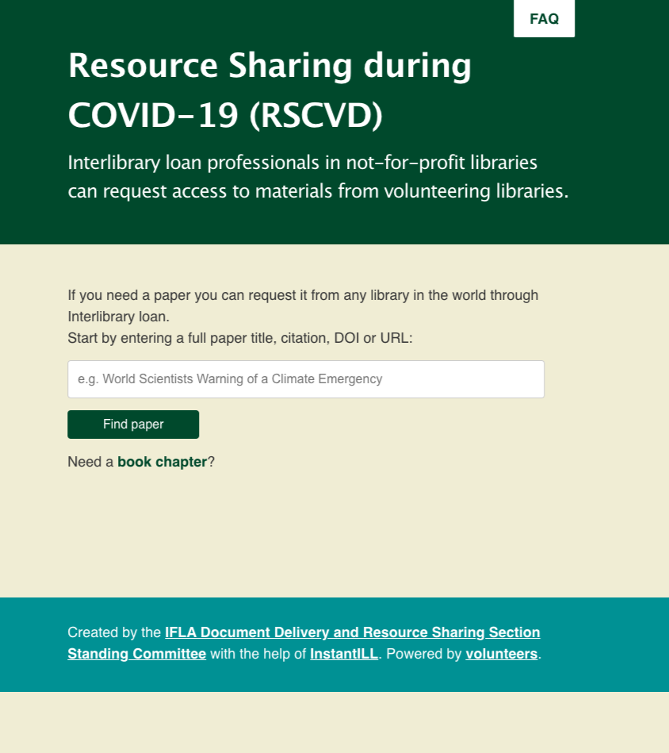

Slide 6
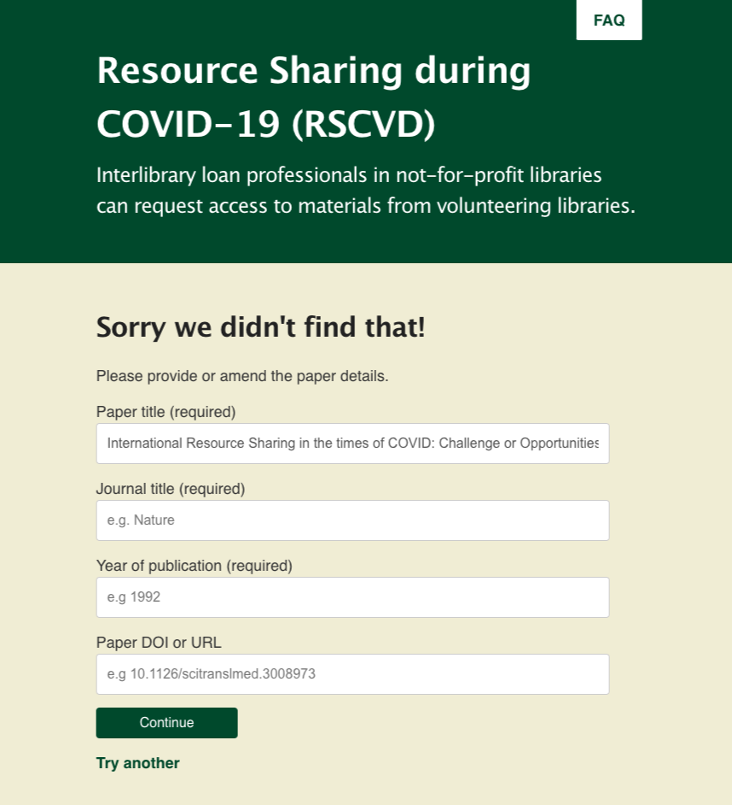

Slide 7
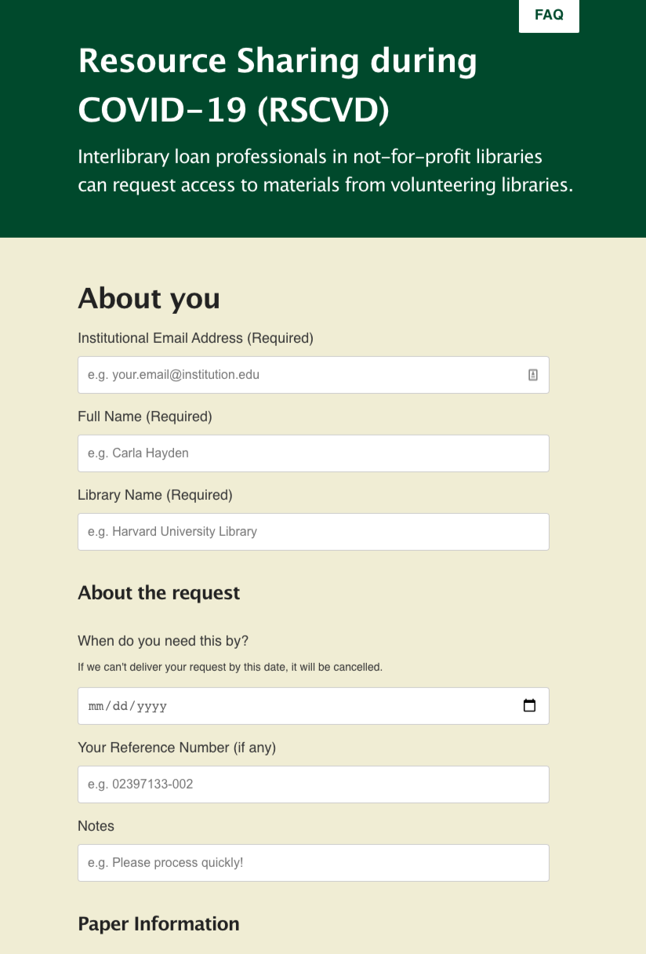

Slide 8
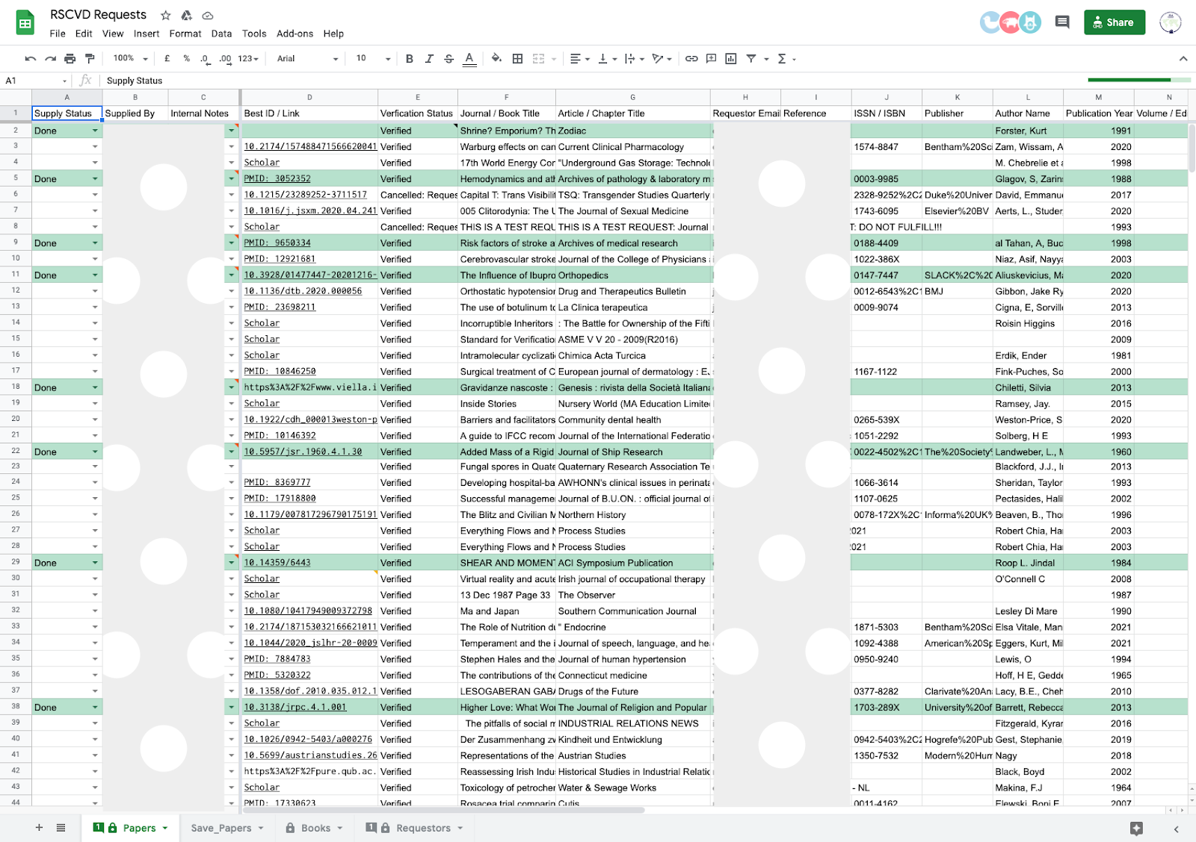

Slide 9
RSCVD (or ‘received’) : Resource Sharing in the times of COVID
Only librarians currently working in a not-for-profit library can make the request (Interlibrary Loan, not Inter-personal loan).
Volunteers are librarians from various institutions.
We verify the requesters(name and Official email addresses).
Electronic Delivery only(book chapters and Journal articles).
FREE Service(simple workflow).
Recommend to follow the Copyrights law of each country.

Slide 10
RSCVD (or ‘received’) : Resource Sharing in the times of COVID
As of July, 2021, 16,113 requests received and 9,062 requests are filled. (56% fill rate)
Requests cam from 28 unique countries.
More than 600 items supplied through Open Access Button.
No average turnaround time but more than 50% of requests were filled within a week.
Volunteers either share the e-resources or scan items or contribute their search skills.
We use secure delivery methods such as OCLC Article Express or RapidX, or others. No email attachment.
Top 5 supplying libraries include, Bahcesehir University Library, MEF University Library, University of Leeds Library, Universidade da Coruña Library, Ozyegin University Library

Slide 11
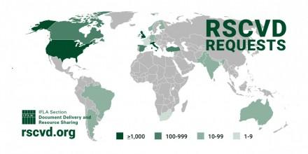
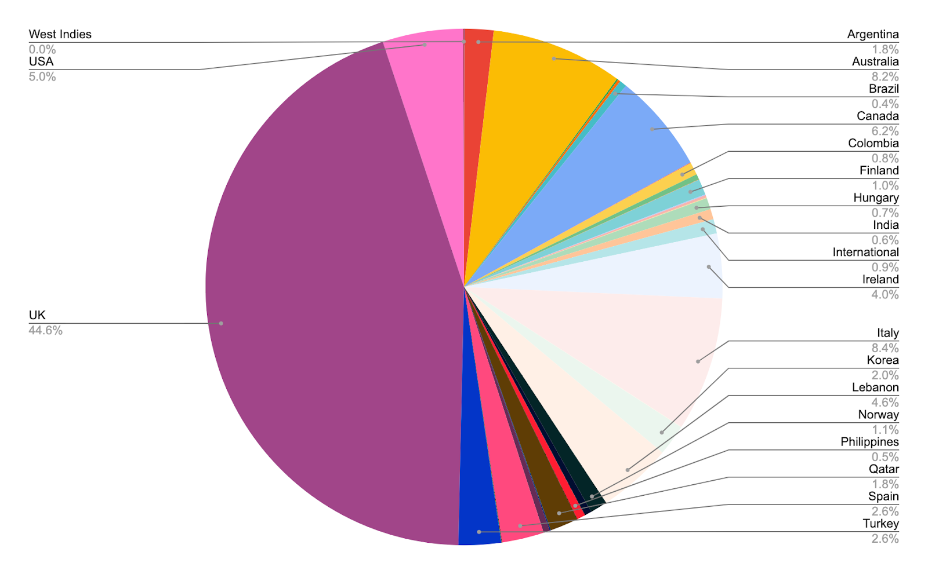
Requests came from

Slide 12
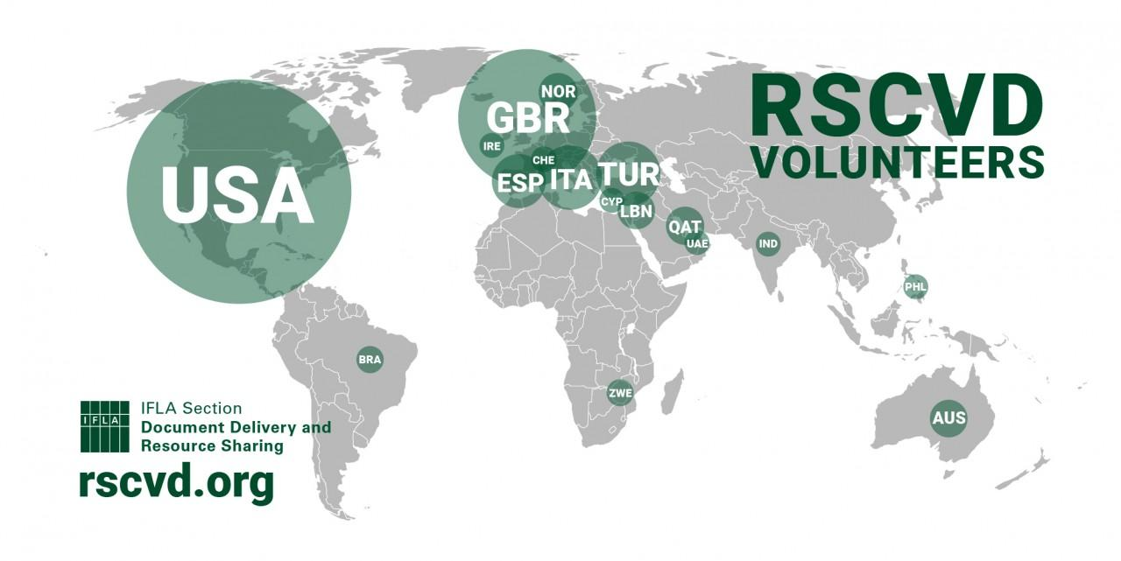
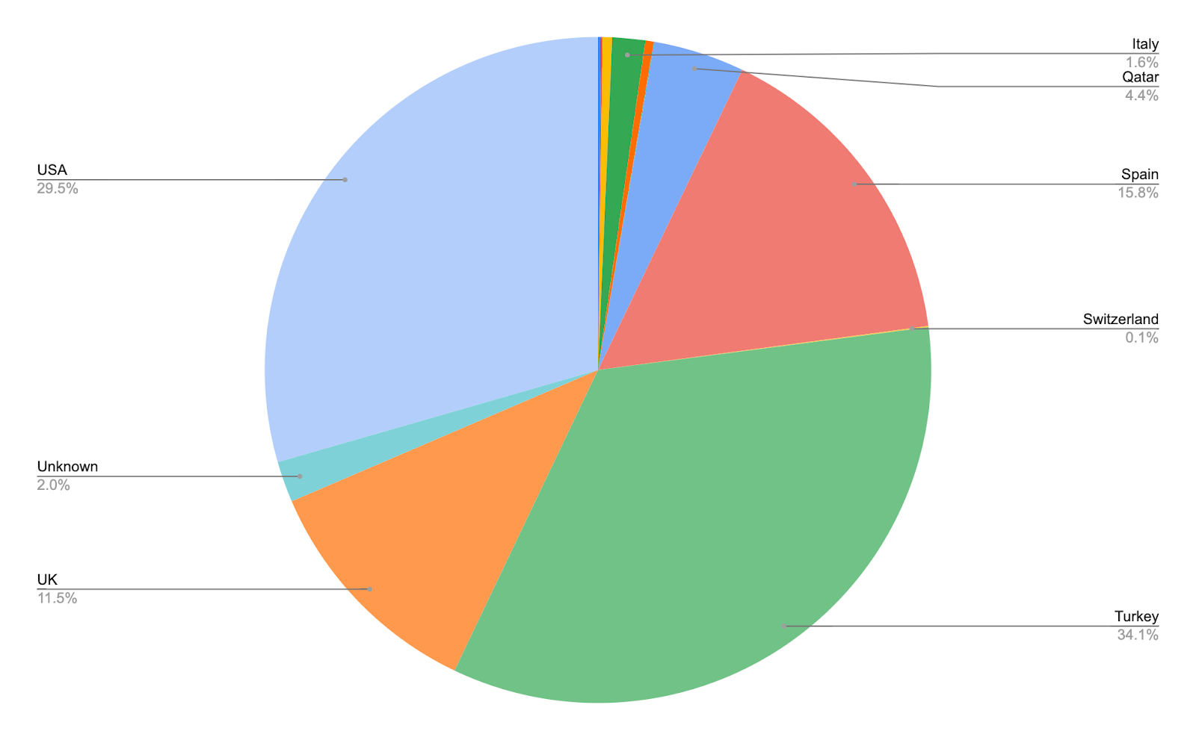
Requests supplied by

Slide 13
RSCVD (or ‘received’) : Resource Sharing in the times of COVID
Future Plans
More stable Platform for International Resource Sharing.
Can we have a secure delivery methods embedded?
What about IFLA Vouchers? hmm…
Platform for the countries without National Resource Sharing platform.
We do not want to replace existing resource sharing network. But we wish to bridge between the National Resource Sharing Networks and fill the gaps.
Organizational structure for a sustainable future(Steering Committee and Volunteers from less participating regions.)
We will not stop as a temporary emergency initiative.
The EU granted ERASMUS funding for the initiative in Feb. 2021.

Slide 14
We make the world better place,
page by page, article by article.
Thank you.
rscvd.org (ifladdrs@gmail.com)
PROJECT NUMBER 2020-1-IT02-KA226-HE-095624 CUP NUMBER B65F21000120006

